Slide 1

Capstone Project Presentation
Title : Online Pizza Ordering System Using Mern Stack
Presented By : R Bhaskar Naik
Guide Name : Abhishek Sharma

Slide 2
Project Overview
Pizza Hub is a web-based application that allows users to browse pizzas, place orders, and track their orders online.
Purpose of the Project
Simplify online food ordering
Provide a smooth user experience
Allow admins to manage pizzas and orders
Key Users
Customers
Admin

Slide 3
Technology Stack
Frontend
React.js
Bootstrap
Redux (State Management)
Backend
Node.js
Express.js
Database
MongoDB

Slide 4
Key Features
User Features
User Registration and Login
Browse pizza menu
Add items to cart
Place orders
Admin Features
Manage menu items
Manage users
Update order status
View dashboard statistics

Slide 5
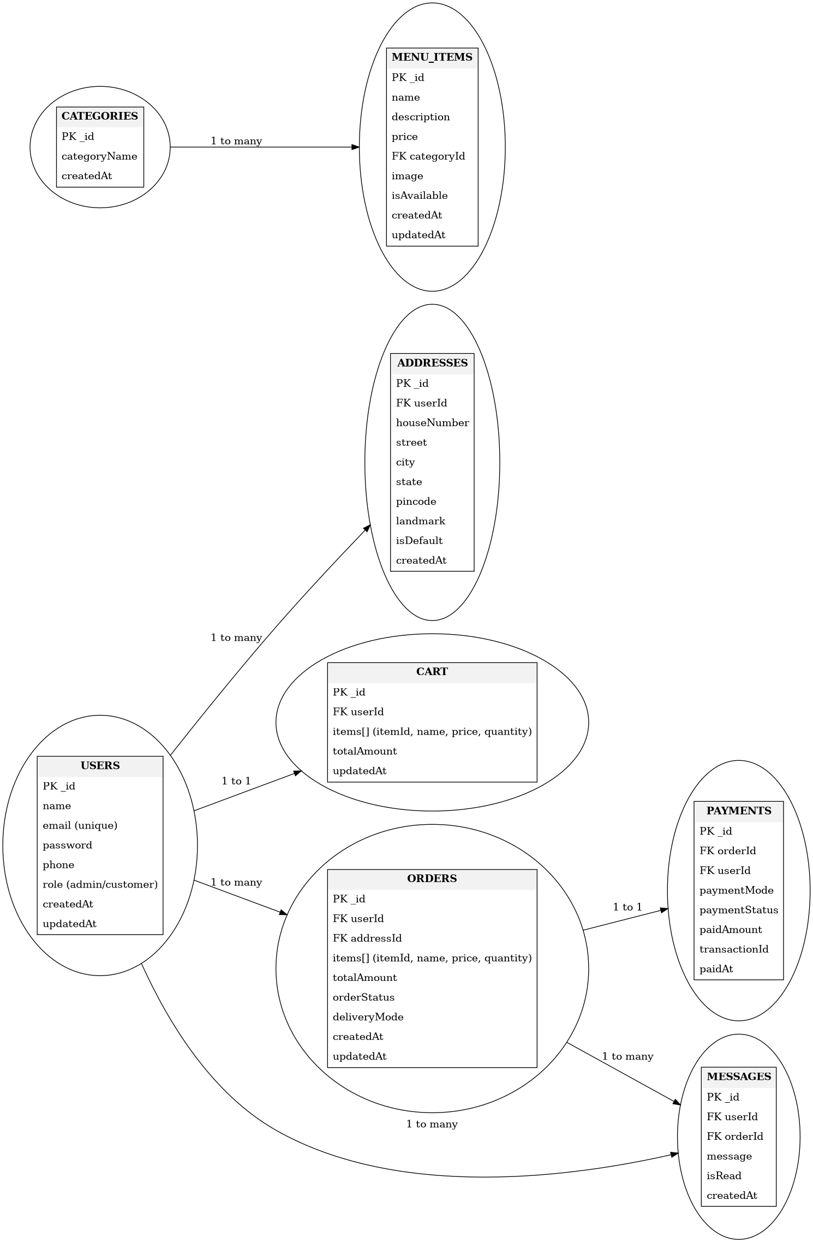
ER Diagram

Slide 6
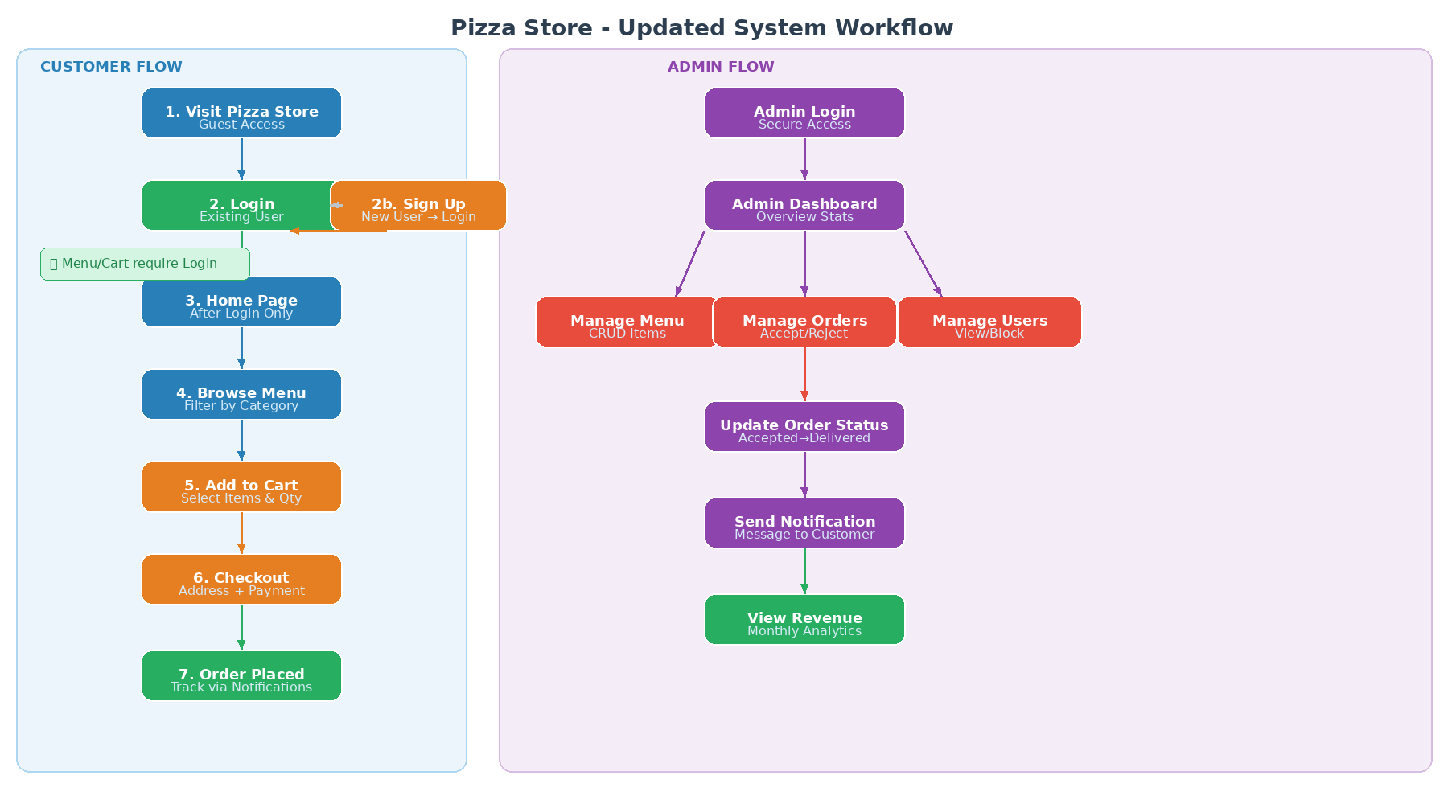
System Workflow
Login required before browsing menu or adding to cart

Slide 7
Application Screenshots
User & Admin Interface Showcases

Slide 8
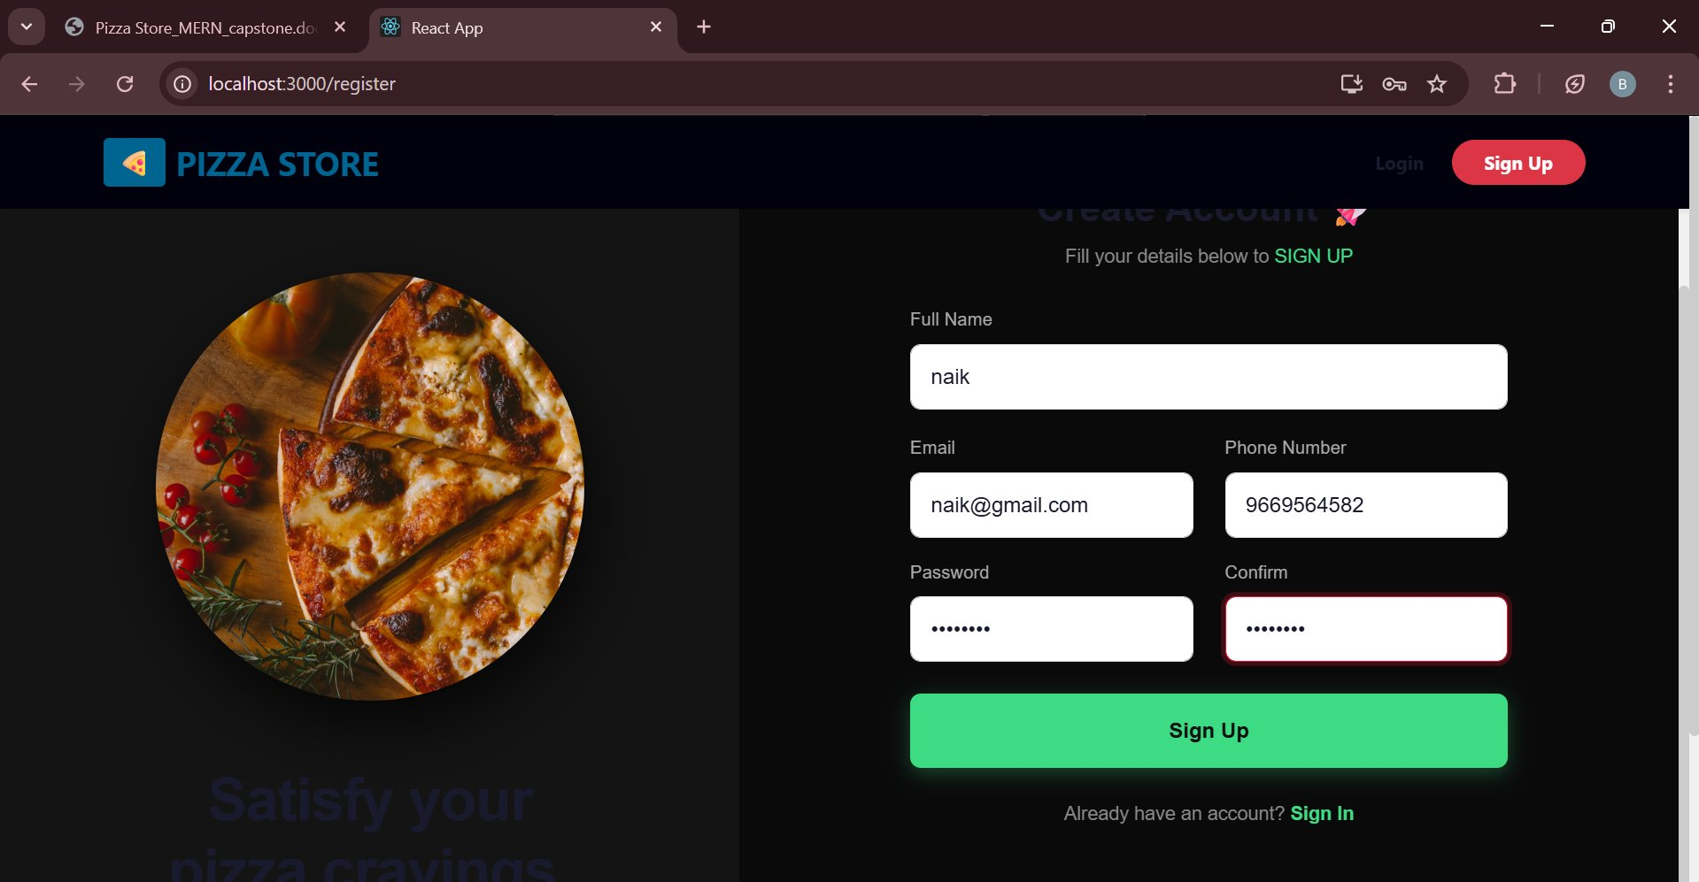
User Signup
New User Registration Page

Slide 9
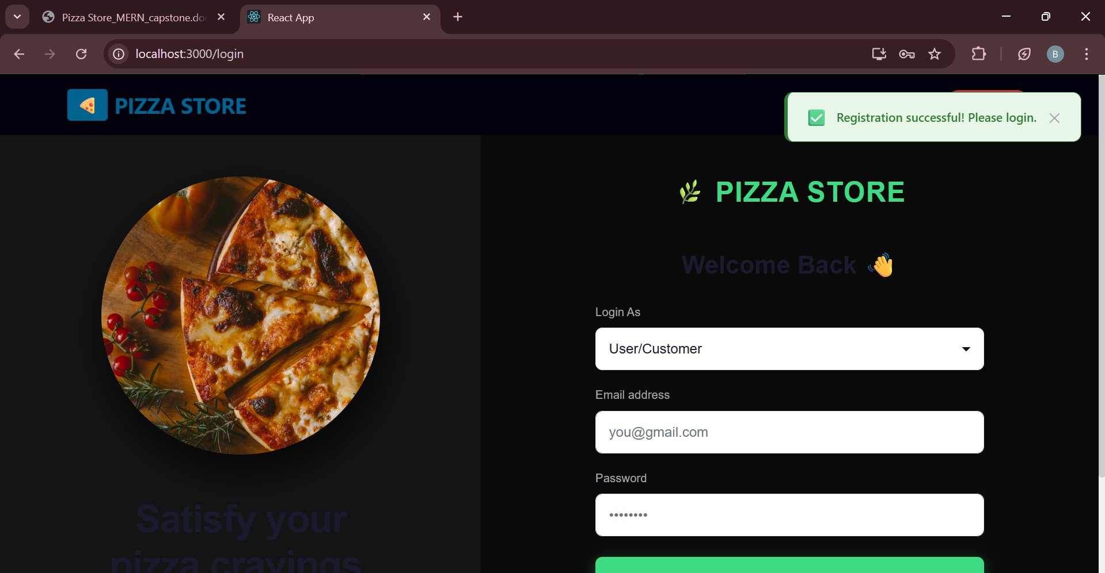
User Login
Login with Role Selection

Slide 10
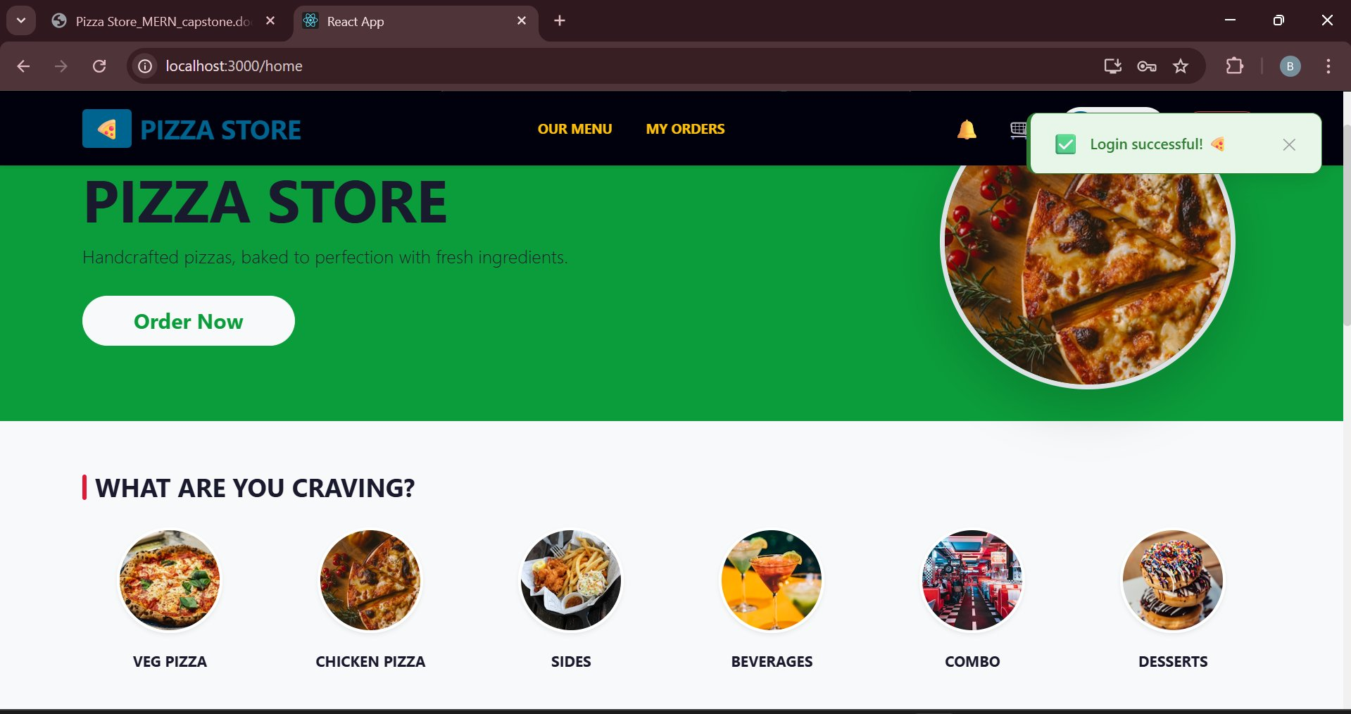
Home Page
After Login - Browse Categories

Slide 11
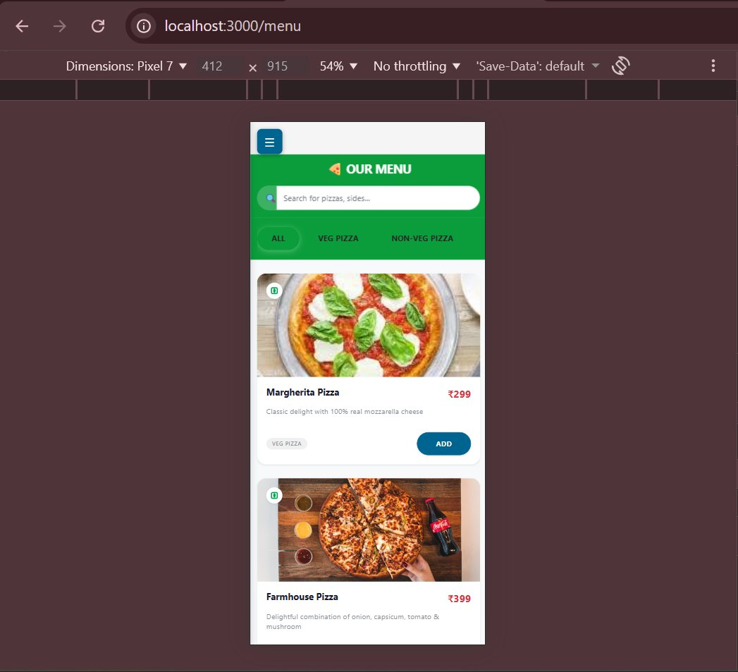
Responsive Mobile View
SPA - Menu on Mobile (Pixel 7)

Slide 12
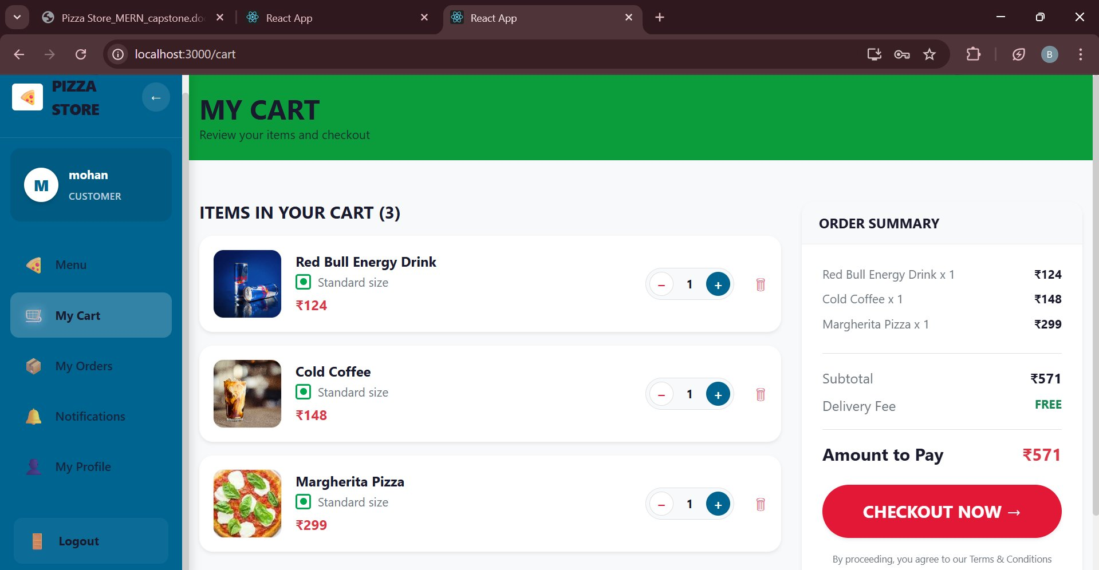
User Cart
Browse Veg, Non-Veg & More

Slide 13
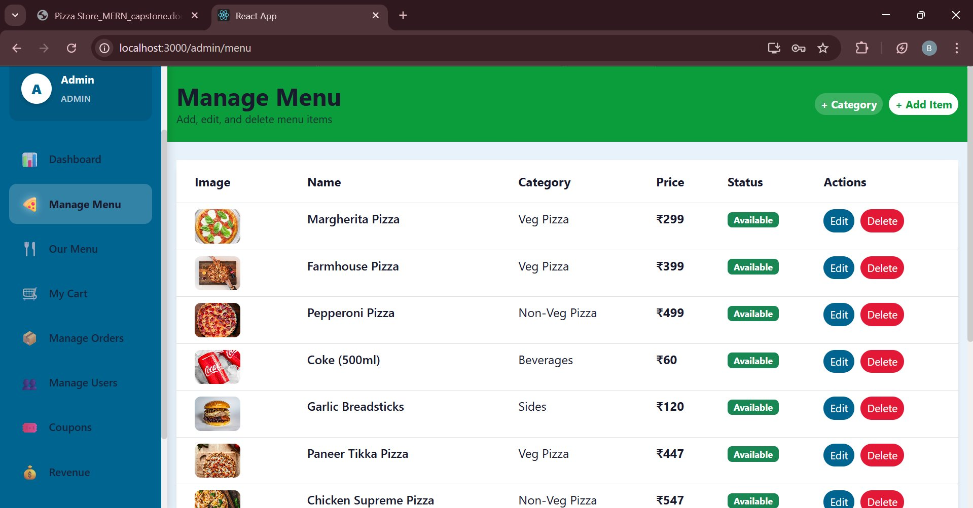
Admin CRUD - Manage Menu
Add, Edit & Delete Menu Items

Slide 14
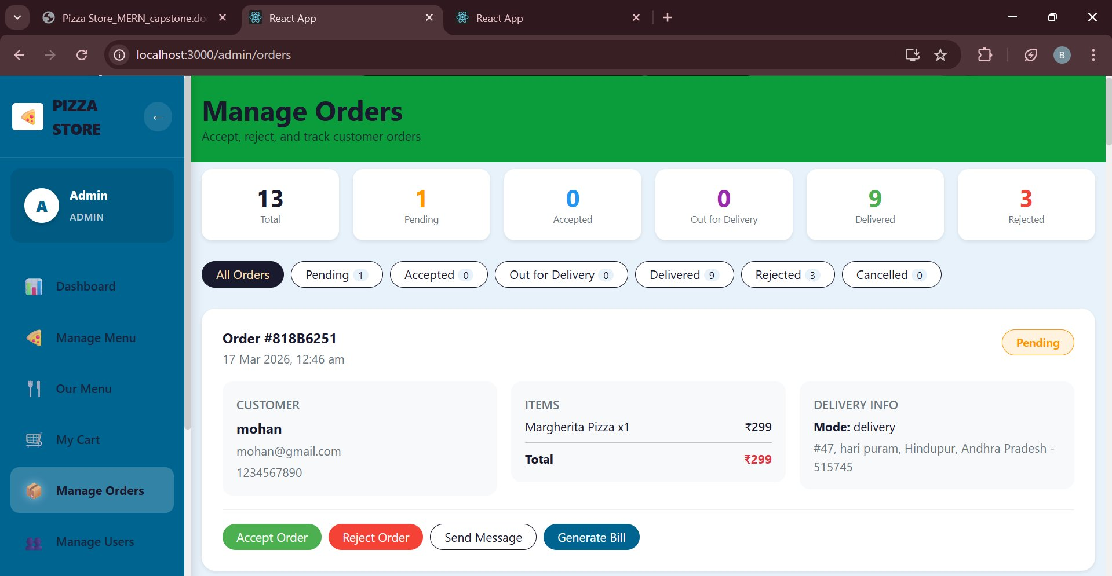
Admin - Manage Orders
Accept, Reject & Track Orders

Slide 15
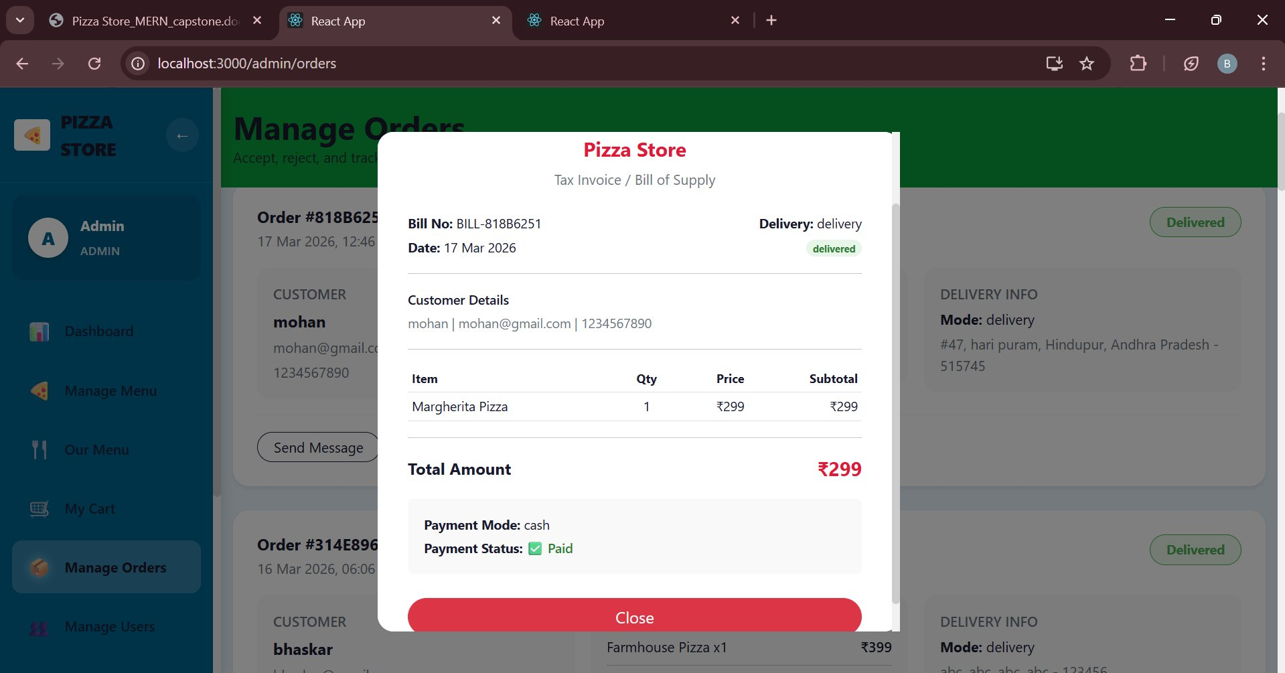
Admin - Generate Bill
Tax Invoice / Bill of Supply

Slide 16
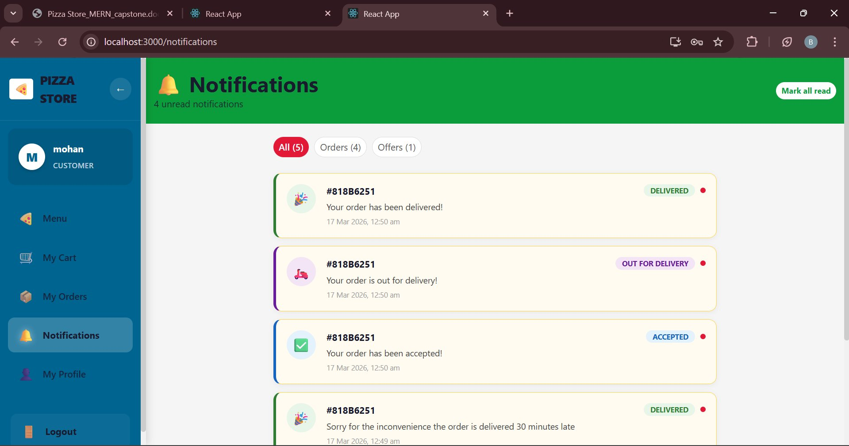
Customer Notifications
Order Status Notifications

Slide 17
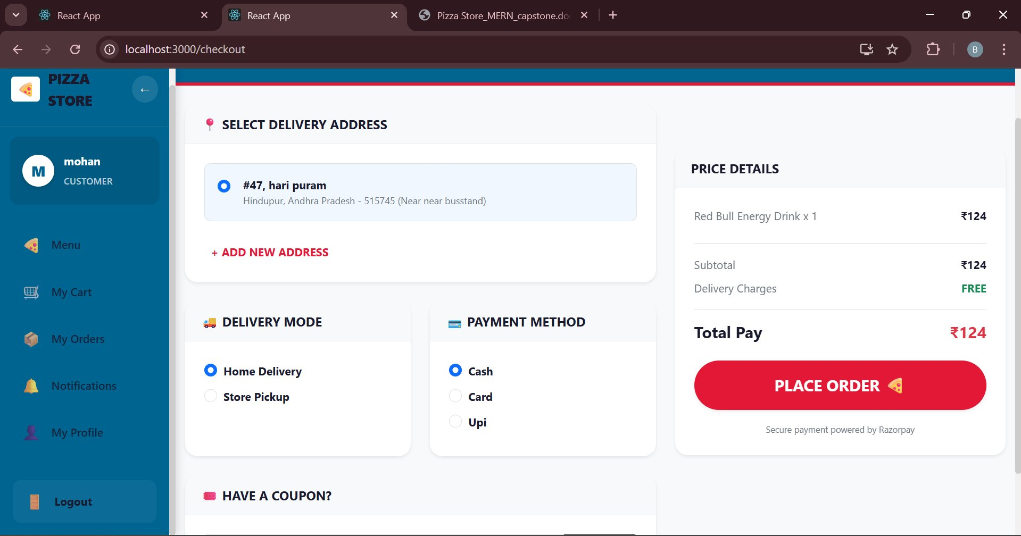
Delivery Mode Selection
Home Delivery or Store Pickup

Slide 18
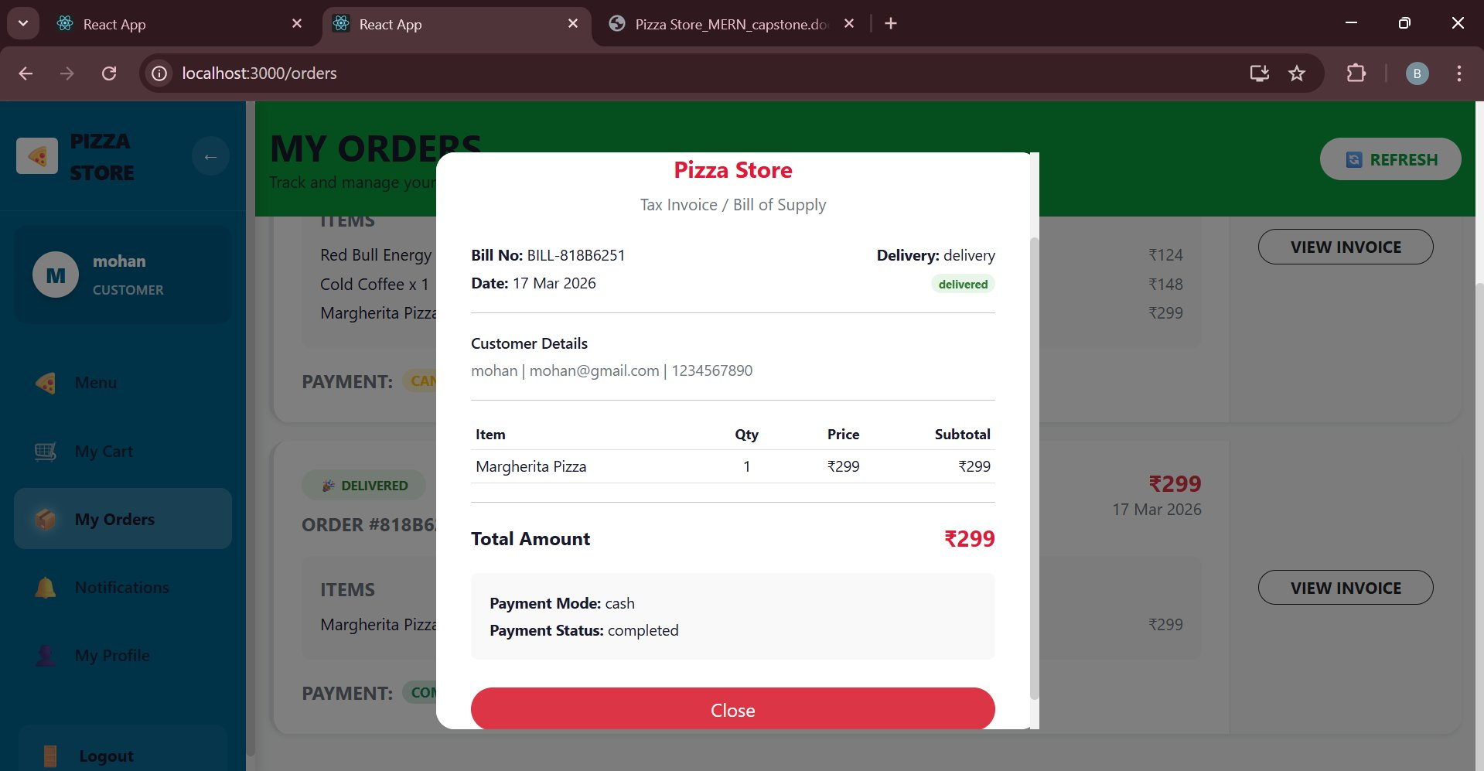
User Bill / Invoice View
Customer Invoice from My Orders

Slide 19
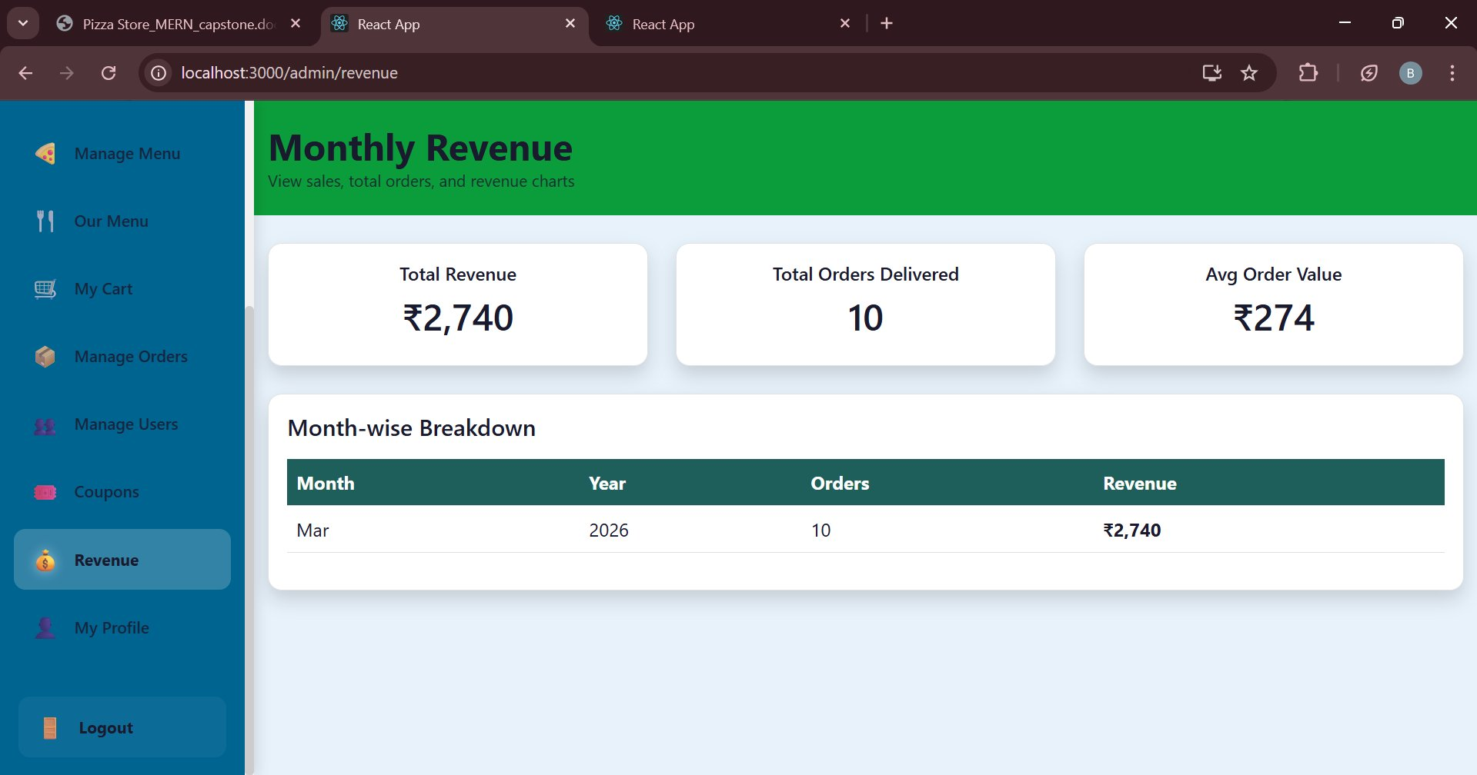
Monthly Revenue Dashboard
Admin Revenue Analytics

Slide 20
Future Improvements
Online Payment Integration Enable secure payments using UPI, cards, and wallets.
Real-Time Order Tracking Allow users to track orders with live status updates.
AI-Based Recommendations Provide personalized suggestions and chatbot support.
Enhanced Security Implement 2FA, secure authentication, and data protection.

Slide 21
Conclusion
Project Outcomes
Successfully built a full-stack pizza ordering system
Implemented secure authentication
Developed admin and user modules
Improved skills in MERN stack development

